Slide 1
Supply Chain Management System
Fetch.ai

Slide 2

Description
Challenges in Traditional Supply Chains:Inefficient handling of orders and inventory.Lack of real-time visibility and tracking.Poor communication between supply chain entities (suppliers, manufacturers, distributors, retailers).Need: A streamlined, efficient system to handle orders, track materials, and coordinate between different roles in the supply chain.

Slide 3
Problem Statement
Challenges in Traditional Supply Chains:Inefficient handling of orders and inventory.Lack of real-time visibility and tracking.Poor communication between supply chain entities (suppliers, manufacturers, distributors, retailers).Need: A streamlined, efficient system to handle orders, track materials, and coordinate between different roles in the supply chain.

Slide 4
Solution Overview
A comprehensive Supply Chain Management System integrating advanced technologies to improve operational efficiency.Key Features:Automated Order Placement and TrackingReal-time Communication Between Supply Chain RolesData-Driven Decision Making with Interactive Visualizations

Slide 5
Tech stack: front-end
React.js
Framework for building dynamic user interfaces.Three.js & React Three
Material ui
A React component library that provides pre-designed UI components, ensuring a consistent and professional design.
Fiber
For creating interactive 3D visualizations.
glassmorphism
A design trend involving frosted glass effects for a modern, sleek look, implemented through CSS for a visually appealing UI.

Slide 6



Tech stack: back-end
FLASK
UAgents
Other tools
A lightweight Python framework for building web applications and APIs. It handles routing, data processing, and integrates with UAgents.
A framework for building multi-agent systems. It manages the different roles (Supplier, Manufacturer, Distributor, Retailer) and their interactions through HTTP endpoints.
For integration and features related to decentralized systems

Slide 7
Frontend Implementation
User Interface:
Glassmorphism Design:
Utilized glassmorphism for a modern and appealing UI, providing a frosted glass effect with transparency.
Interactive Charts:
Integrated Chart.js for dynamic and interactive visualizations, enabling users to track order status and performance metrics in real-time.
Components:
Order Placement: Input fields and buttons for placing orders, sending materials, and checking status.
Order History: List displaying historical order data with statuses and details.Status
Updates: Real-time status updates and feedback.

Slide 8
Ui/ux
User Interface
React.js Component
Material UI Integration
Glass-morphism
Modular components for different functionalities (order placement, status checking).
Consistent styling with pre-designed components for buttons, input fields, and containers.
Achieved using CSS, creating a frosted glass effect for a modern and visually appealing look.

Slide 9
Ui/ux
User Experience
Responsive Design
Interactive Elements
Charts and Graphs
Ensures compatibility with different devices and screen sizes.
Includes buttons, input fields, and dynamic charts for enhanced user interaction.
Interactive charts for visualizing data (e.g., order history, material status).

Slide 10
Backend Implementation
Flask Framework:
Routing: Defines endpoints for order placement, material handling, and status checking.
Error Handling: Robust error handling mechanisms to ensure smooth operations and informative responses.
UAgents:
Supplier Agent: Manages supplier interactions and processes incoming orders.
Manufacturer Agent: Handles manufacturing tasks and material processing.
Distributor Agent: Coordinates distribution of goods.
Retailer Agent: Manages retail operations and customer interactions.
Contract Management: State machine contracts for managing transitions between different supply chain states.

Slide 11
Approach and Methodology
Development Phases
Phase 1: Requirement Analysis and Design
Phase 2: Backend Development with Uagents
Phase 3: Frontend Development with React and Interactive Elements
Phase 4: Integration and Testing
Integration: Ensured seamless communication between frontend and backend through well-defined API endpoints.
Testing: Comprehensive testing of all functionalities to ensure reliability and performance.

Slide 12
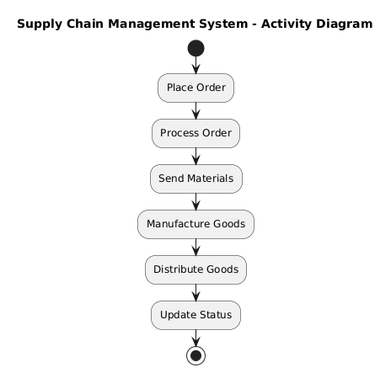
ACTIVITY DIAGRAM

Slide 13
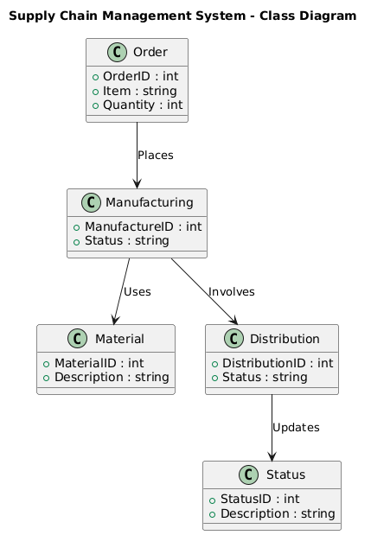
CLASS DIAGRAM

Slide 14
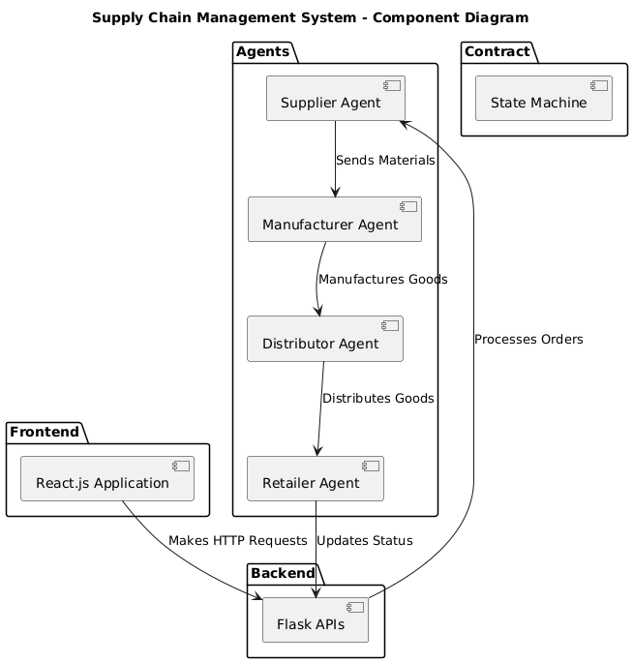
COMPONENT DIAGRAM

Slide 15
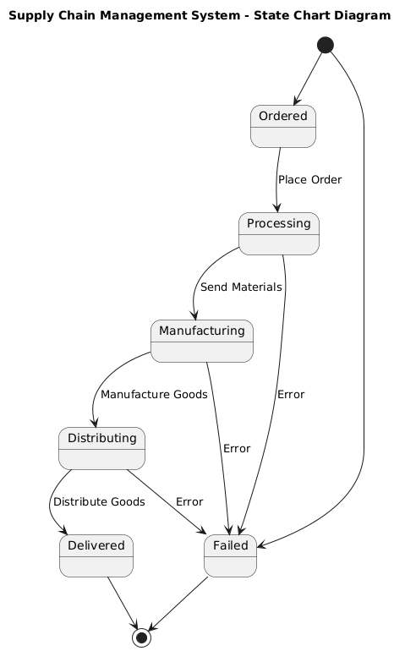
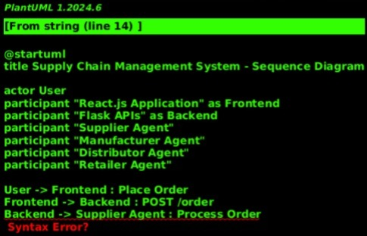
STATE TRANSITION DIAGRAM

Slide 16
features
Order management
Material handling
Users can place orders through the frontend interface. The order details are sent to the backend, processed, and stored. - Order history is displayed, showing item names, quantities, and statuses.
Automated processes for sending and receiving materials between agents, enhancing efficiency and reducing manual effort.

Slide 17
features
Manufacturing & Distribution
Real-Time Status
Agents manage the production and distribution of goods, ensuring timely fulfillment and tracking.
Provides real-time updates on order status, material handling, and other supply chain processes.

Slide 18
Our competition graphic
Challenges faced
Solutions implemented
Difficulties in synchronizing frontend and backend components.
Resolved integration issues by refining API endpoints and frontend logic.
Ensuring robust error handling and logging for smooth operation.
Implemented comprehensive error handling and logging mechanisms to track and address issues effectively.

Slide 19
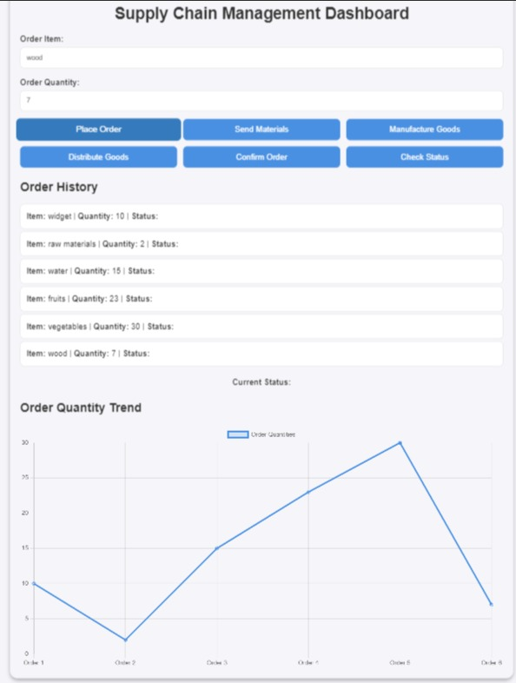
IMPLEMENTATION
https://fetchai-dapp.netlify.app/

Slide 20
Results & impact
Key metrics & Impacts
Key metrics
Impact
Efficiency Improvement:
Reduced order processing time by [specific percentage or time], streamlining operations.
User Engagement:
Enhanced user interaction through dynamic and responsive UI elements.
Operational Efficiency:
Streamlined supply chain processes with improved transparency and reduced delays.
User Feedback:
Positive responses from users and stakeholders regarding the system’s functionality and design.

Slide 21
Future work
ADVANCED ANALYTICS
Extended Integration
Develop analytics and reporting features for deeper insights into supply chain performance.
Integrate with additional supply chain partners and platforms for broader applicability.
System Scalability
Blockchain Integration
Scale the system for larger and more complex supply chains.
Explore blockchain technology for added security and decentralization.

Slide 22
CONCLUSION
Summary:
Recap of the project’s objectives, approach, and outcomes. Emphasize key achievements and improvements.
Acknowledgments:
Thank collaborators and Fetch.ai for their support and the opportunity to present this project.

Slide 23
Market opportunity overview
VVS LAXMAN
M POOJITH CHOWDARY
M BUDDU UDAY
N MAHIDEEP
GitHub:
https://github.com/Vvslaxman
GitHub: https://github.com/Poojith-Chowdary
GitHub:
https://github.com/Morampudi-Buddu-Uday
GitHub:
https://github.com/matrix-09

Slide 24
Thank you

